Slide 1
Machine Learning and Business,
3rd Edition
Chapter 8: Reinforcement Learning

Slide 2
Reinforcement Learning
Reinforcement learning is concerned with finding a strategy for taking a series of decisions rather than just one
The environment is usually changing unpredictably

Slide 3
Rewards and costs
There are rewards and costs and the algorithm tries to maximize expected rewards (net of costs) in its interaction with the environment
Exploitation vs. Exploration (Should you choose best decision based on evidence to date or try something new?)
Action evaluated by the sum of expected rewards (net of costs) that come after it (possibly discounted)

Slide 4
Well known successes
Has been used to develop software that can beat the best human players of games such as chess and Go
In early attempts to play these games, software learned from games played by the best human players (e.g Stockfish)
AlphaZero improved on these approaches by using reinforcement learning. Algorithm is only given the rules of the game and learns by playing against itself many times

Slide 5
A Simple Example: K-armed bandits
You are in a casino and have to choose between K levers
Lever k provides a return from a normal distribution with mean m_{k} (which is unknown) and standard deviation 1
Objective is to maximize your return over a large number of trials

Slide 6
Strategy
You keep records of the average return from choosing each lever
At each turn you have to decide between
    Choose the lever that has given you the best average return so far (the “greedy action”)
    Try out a new action
The first choice is exploitation; the second is exploration.
We can choose a parameter ε equal to the probability of exploration
Exploitation maximizes the immediate expected return but exploration may do better in the long run

Slide 7
The Math (page 174)
Suppose that lever k has been chosen n−1 times and the total reward on the jth time it is chosen is R_{j}
Expected reward is
If kth lever is chosen for the nth time and produces a reward R_{n}

Slide 8
The exploration parameter ε
The exploration parameter, ε, is usually set equal to 1 initially and reduces as learning takes place.
If the decay factor is β, the value of epsilon on a trial is β times its value on the previous trial

Slide 9
4 bandits (m₁=1.2, m₂=1, m₃=0.8, m₄=1.4); ε starts at 1 but has a decay factor of 0.99
Initially Q-values are set equal to zero. (Table 8.3)
Decay factors of 0.9 and 0.999 work tend to work less well (Tables 8.2 and 8.4)

Slide 10
The More General Model: Actions and States (Figure 8.1)
Initial State
Action Taken time 0
Reward time 1 State time 1
Action Taken time 1
S₀
A₀
R₁
S₁
A₁
A₃
R₃
S₃
A₂
R₂
S₂
Action Taken time 3
Reward time 3
State time 3
Action Taken time 2
Reward time 2
State time 2

Slide 11
Objective
Objective could be to maximize the expected value of rewards
G=R₁+R₂+R₃+……+R_{T}
In some cases, particularly when there is a long or infinite horizon, the objective is to maximize the expected value of discounted rewards:
G=R₁+ γ R₂+ γ²R₃+……..
where γ is a discount factor

Slide 12
Updating
Define Q(S,A) as the value of being in state S and taking action A
Suppose we have just completed the nth trial for state S and action A. Instead of
we usually set
for some parameter α (e.g. 0.05)

Slide 13
A Simple Example: the game of Nim
There is a pile of N matches. Two players take it in turns to pick up one, two, or three matches.
Last player to pick up loses
State is the number of matches. Action is number picked up. Reward occurs at the end (=+1 if you win and -1 if you lose)
What is the optimal strategy?
We can work back from the end of the game.
What if it is your turn and there are 2, 3, 4, 5, 6,… matches?

Slide 14
Using Monte Carlo
This works similarly to the 4-armed bandit example
In that example we had 4 actions
Here we consider state-action combinations
Define Q(S,A) as the value of being in state S when action A is taken
We might initially set all the Q(S,A) to zero
We simulate a set of actions

Slide 15
Using Monte Carlo continued
There is a chance (1-ε) that we choose the best action so far for any given state and ε that we randomly choose an action
Define G as the total reward (possibly with discounting) for the complete set of actions taken in one trial
For each {S,A} combination that is encountered on the trial we update as follows
This gives more weight to recent trials. This because the strategy followed and therefore the

Slide 16
Nim with 8 matches in the pile initially
Here are the initial values for the state/action combinations
Matches picked up | State (=number of matches left )
 | 2 | 3 | 4 | 5 | 6 | 7 | 8
1 | 0 | 0 | 0 | 0 | 0 | 0 | 0
2 | 0 | 0 | 0 | 0 | 0 | 0 | 0
3 |  | 0 | 0 | 0 | 0 | 0 | 0

Slide 17
Nim continued
Opponent behaves randomly
Reward for winning is 1; reward for losing is −1
The matches picked up on first simulation (with opponent’s choice in brackets) is
1,[3],1,[3] (win)
We assign a gain, G, of 1 to:
  state 8, action 1
  state 4, action 1
and apply updating formula, setting α = 0.05

Slide 18
Nim after one trial (1,[3],1,[3])
Matches picked up | State (=number of matches left )
 | 2 | 3 | 4 | 5 | 6 | 7 | 8
1 | 0 | 0 | 0.05 | 0 | 0 | 0 | 0.05
2 | 0 | 0 | 0 | 0 | 0 | 0 | 0
3 |  | 0 | 0 | 0 | 0 | 0 | 0

Slide 19
Next trials
Matches picked up | State (=number of matches left )
 | 2 | 3 | 4 | 5 | 6 | 7 | 8
1 | 0 | 0 | 0.05 | -0.05 | 0 | 0 | -0.0025
2 | 0 | 0 | 0 | 0 | 0 | 0 | 0
3 |  | 0 | 0 | 0 | 0 | 0 | 0
Second trial
1,[2],1,[3],1 (lose)

Slide 20
Example of convergence, (Tables 8.9 to 8.11). ε starts at 1 and has a decay factor of 0.9995
After 1,000 trials
After 5,000 trials
After 10,000 trials

Slide 21
Dynamic Programming
Simple sequential decision problems can be solved by dynamic programming where we work back from the end to the beginning calculating the optimal action in each state. The recursion formula for the value V(S) of being in state S is
An alternative to Monte Carlo simulation is temporal difference learning which uses the ideas underlying dynamic programming

Slide 22
Temporal difference learning
Instead of using G (the total, possibly discounted, future rewards) to update, we can use the current value at the next step. The updating formula becomes
where V is the current estimate of the value of being in the state reached at the end the next step. If S* is this state, V is the current maximum value of Q(S*,A) across all actions A that can be taken in the state.
This is referred to a Q-learning

Slide 23
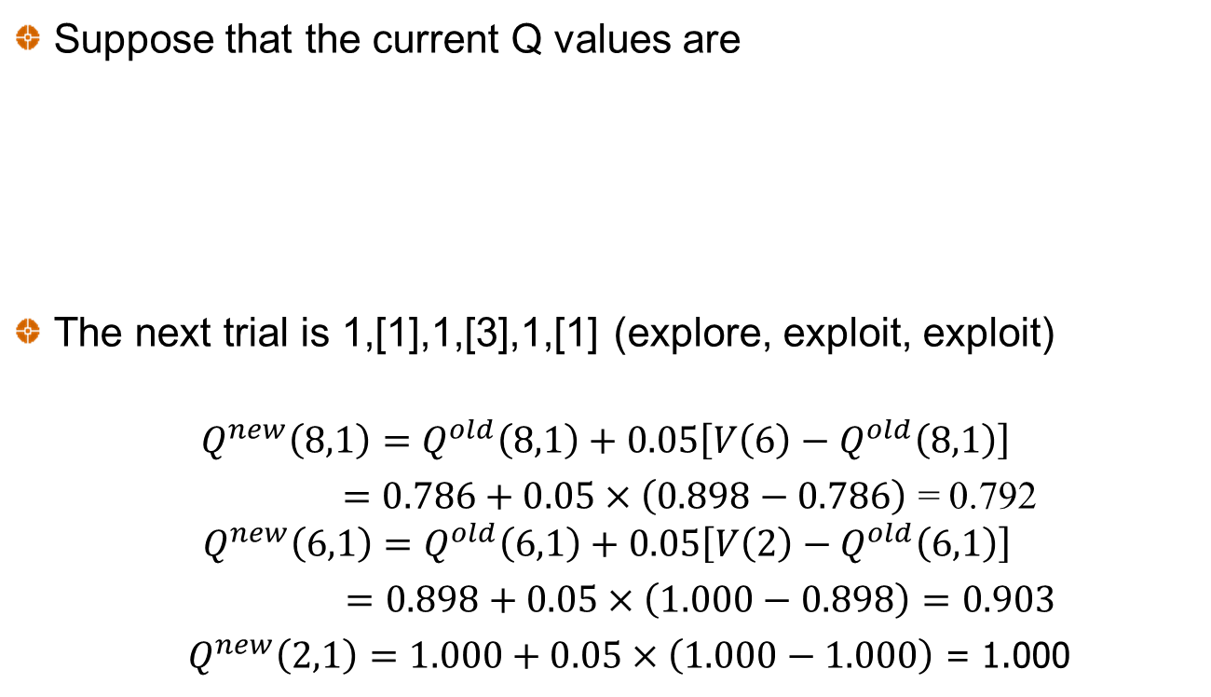
Example (page 158-159)
Suppose that the current Q values are
The next trial is 1,[1],1,[3],1,[1] (explore, exploit, exploit)
$$Q^{new}\left(8,1\right)=Q^{old}\left(8,1\right)+0.05\left[V\left(6\right)−Q^{old}\left(8,1\right)\right]$$
$=0.786+0.05×\left(0.898−0.786\right)$ = 0.792 $Q^{new}\left(6,1\right)=Q^{old}\left(6,1\right)+0.05\left[V\left(2\right)−Q^{old}\left(6,1\right)\right]$
$=0.898+0.05×\left(1.000−0.898\right)=0.903$
    $Q^{new}\left(2,1\right)=1.000+0.05×\left(1.000−1.000\right)$ = 1.000

Slide 24
Example of convergence. ε starts at 1 and has a decay factor of 0.9995. Temporal Difference Learning (Tables 8.12, 8.13, 8.14)
After 1,000 trials
After 5,000 trials
After 10,000 trials

Slide 25
Temporal Difference Results When Opponent Also Learns
After 1,000 trials
After 5,000 trials
After 10,000 trials

Slide 26
n-step bootstrapping
Monte Carlo bases updates on what happens over the complete life of the trial
Temporal difference bases updates on what happens over the next period
n-step bootstrapping algorithms is between the two. It bases updates on what happens over the next n periods

Slide 27
When there are many states or actions (or both)
The cells of the state/action table do not get filled in very quickly
It becomes necessary to estimate the Q(S,A) function from observed values.
As this function is in general non-linear a natural approach is to use artificial neural networks (ANNs).
We use an ANN to minimize the sum of squared errors between the estimates and the target
This is known as deep Q-learning or deep reinforcement learning

Slide 28
Applications
Games such as Go and chess
Driverless cars
Programming of traffic lights
Healthcare
Finance applications
  Optimally selling a large block of shares
  Portfolio management where there are transaction costs
  Hedging

Slide 29
Data Requirements
Reinforcement learning is very data hungry
In many situations there is not enough real-life data to train the model
An approach often used is to estimate the process generating real-life data and then simulate from this process
An alternative is to use machine learning to generate data that is indistinguishable from historical data. One approach for doing this is to use variational autoencoders. Another is to use generative autoencoder networks.

Slide 30
Hedging Derivatives Portfolios
Hedging is a sequential decision making problem
In the absence of transaction costs, each decision can be made independently of each other decision
When there are transaction costs, reinforcement learning can be used to develop a multi-period strategy

Slide 31
Portfolio Management
Reinforcement learning also has applications in portfolio management
In taking a decision today it is necessary to consider how further decision will be taken as the environment changes

Slide 32
Optimal Trade Execution
If a trader has a large block of shares to sell (or buy) what is the optimal strategy
One large trade is likely to have a negative impact on the price per share
A series of small trades exposes the trader to market risk.

Slide 33
A Simple Example
A trader wants to sell 10 million shares over at most 10 days to maximize the expected price received
The bid-mid spread for small trades is highly variable with 0.5%, 0.6%,….1.5% being equally likely
For large trades the bid-mid spread increases by 0.05q where q is the number of shares traded.
If all shares are traded at once the expected mid-bid cost is 1.5%. If they are traded one million per day over 10 days the mid-bid spread is 1.05%.
Reinforcement learning shows that this can be reduced to 0.934%.

